Slide 1

AssetWizzards
Asset
Management:

Slide 2

Introduction to Asset Management
E-Asset Management System is a powerful solution designed to revolutionize asset management and tracking .
Efficiently managing a range of assets.
Help Borrowers for their undisrupted flow of work.

Slide 3



Problem Statement
Current asset management practices are inefficient and error-prone, leading to suboptimal resource utilization and increased operational costs. Our project aims to develop a web-based E-Asset Management System to streamline tracking, enhance accountability, and optimize asset management processes.

Slide 4
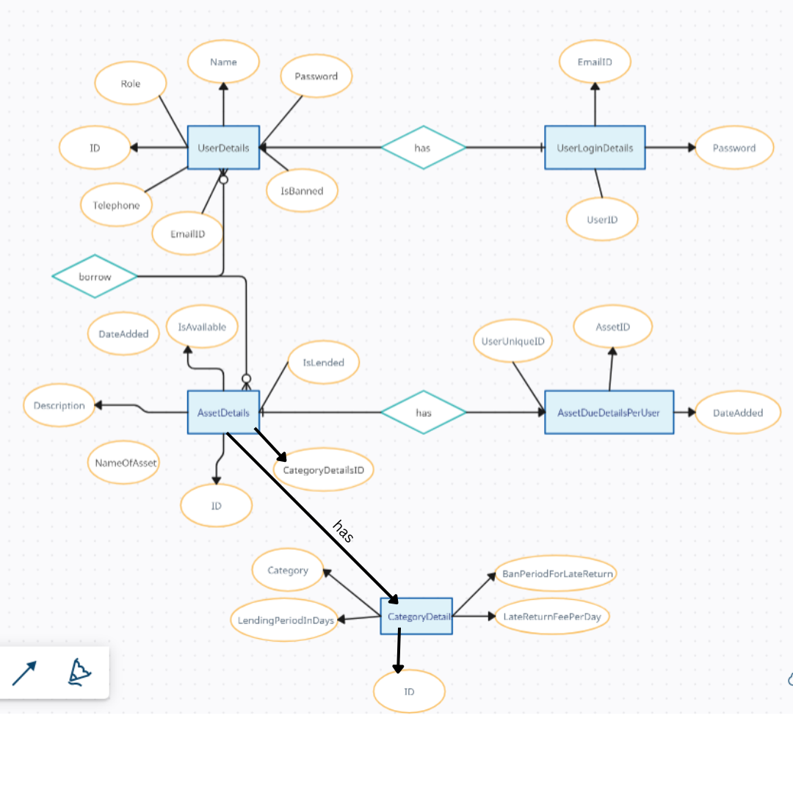
ER Diagram of the System

Slide 5
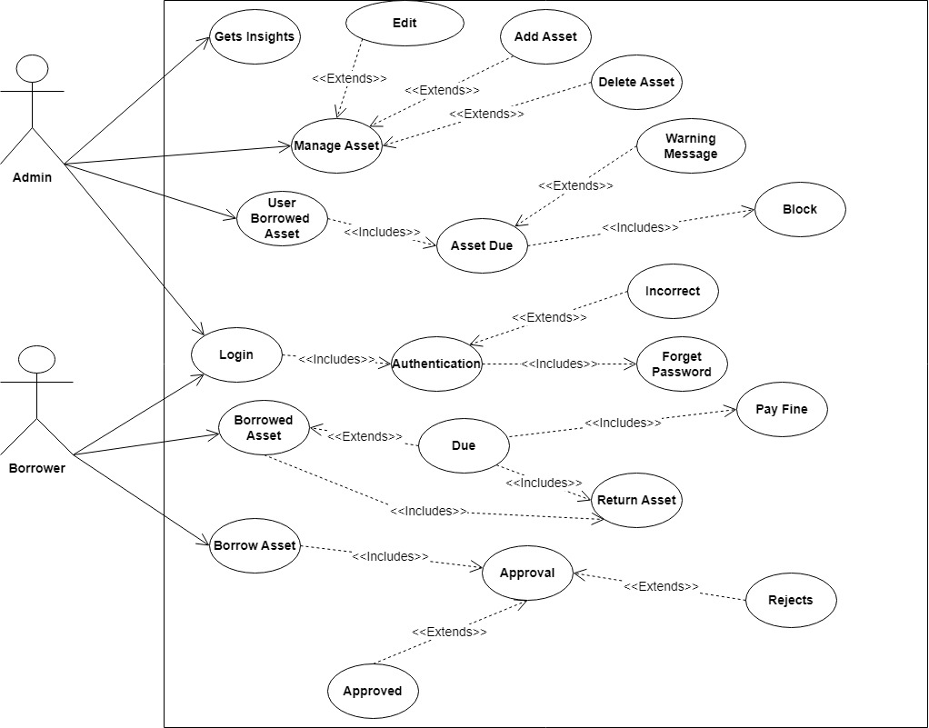
Use Case Diagram of the System

Slide 6
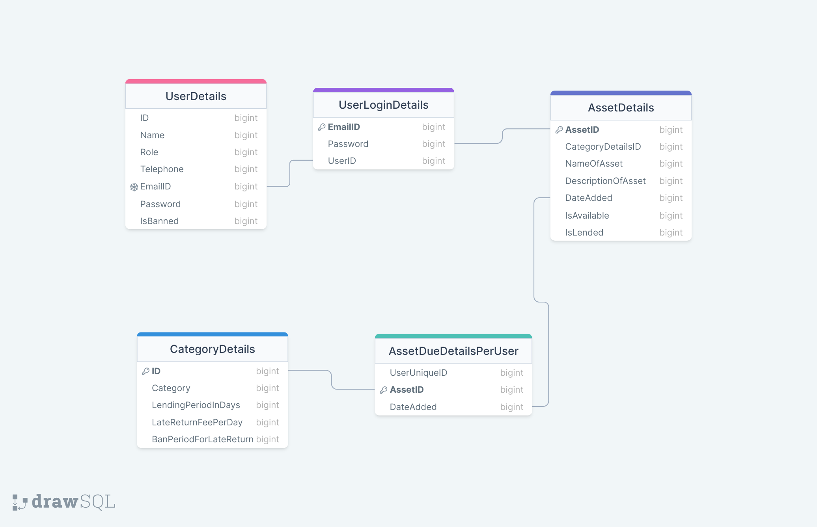
Class Diagram of the System

Slide 7

Work Flow
Firstly, User Page will appear
There are two types of Users:
Admin
Borrower
Login by entering the Credentials
Admin is already Registered and If Borrower doesn't exist then Register first
Landing Page appears

Slide 8
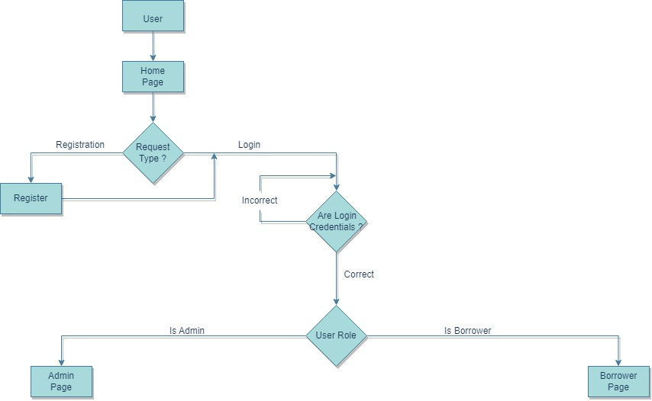
User's Page

Slide 9
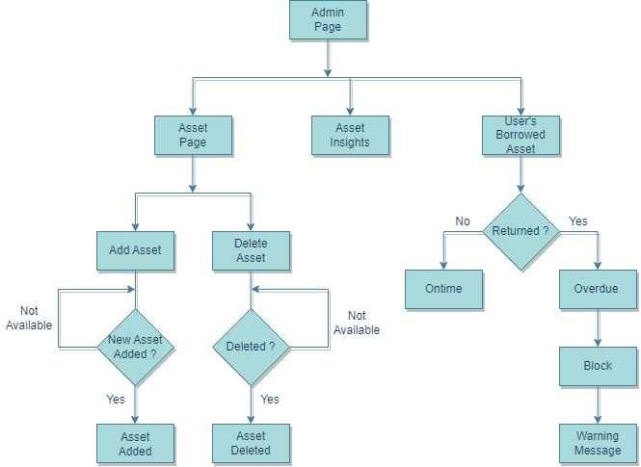
Admin's Page

Slide 10
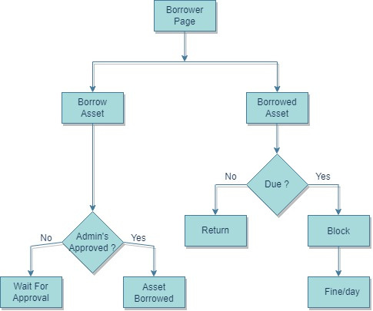
Borrower’s Page

Slide 11

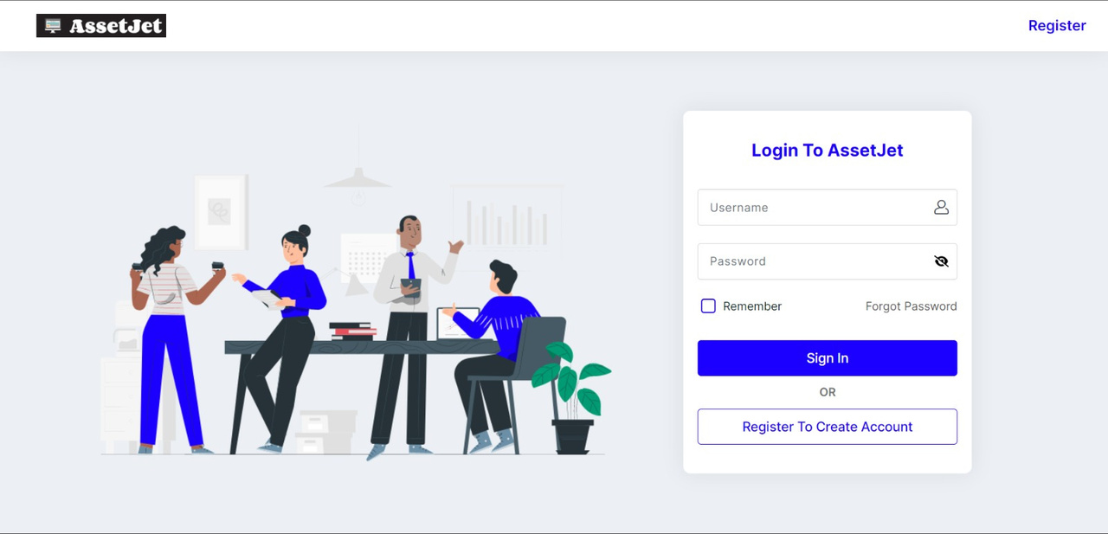
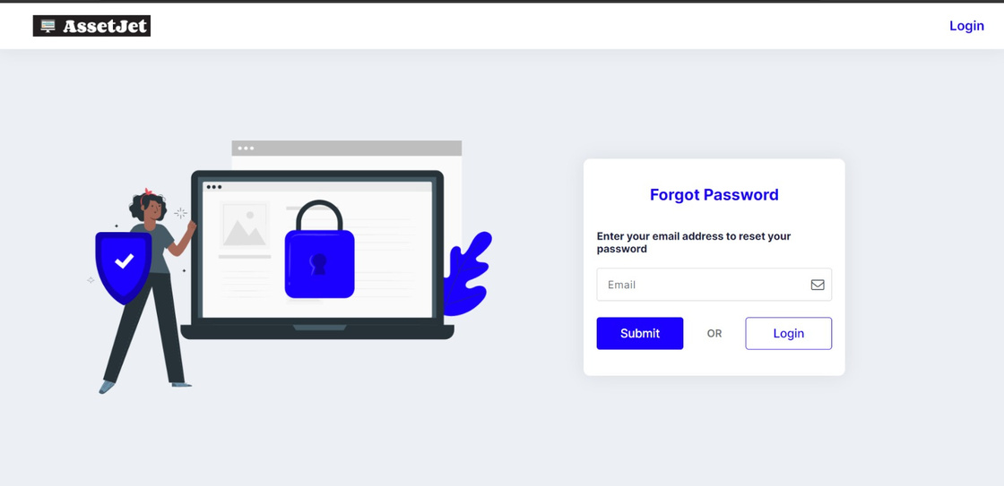
Login Page
If user forgets password

Slide 12
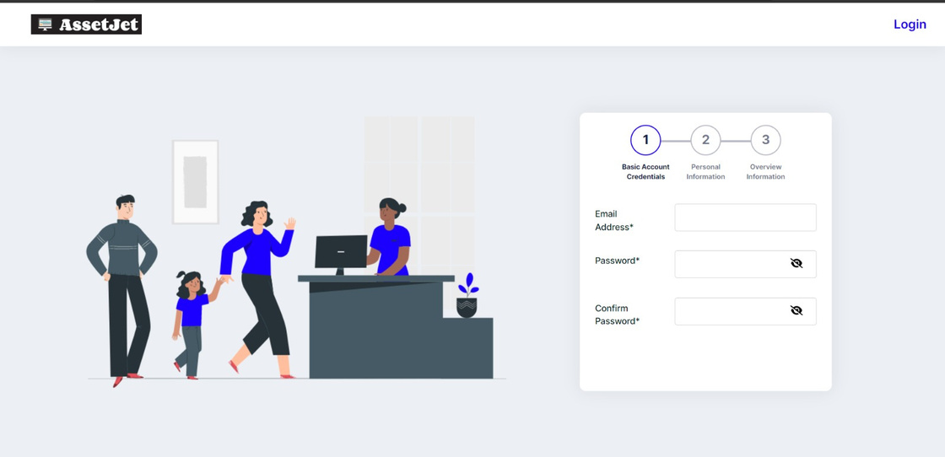
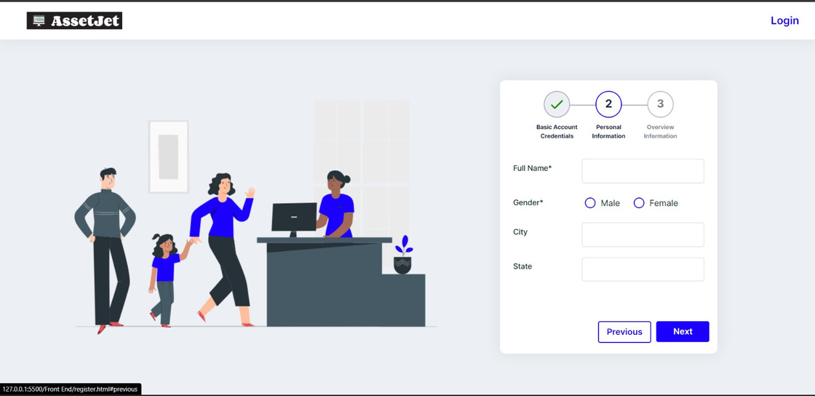

Slide 13


Slide 14
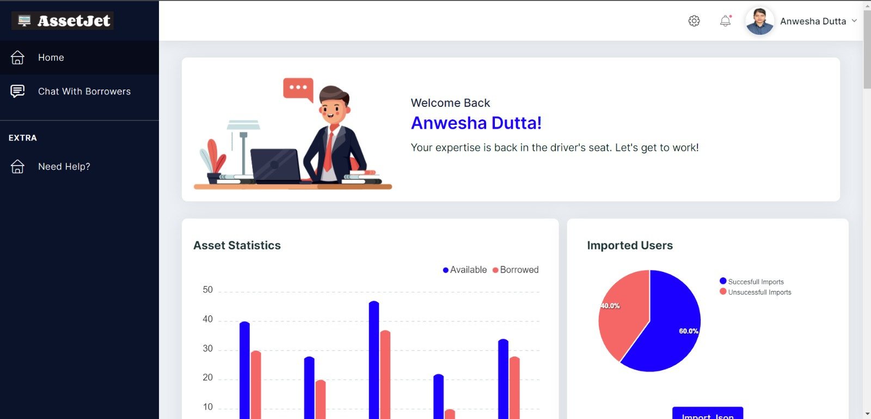
Admin's Portal

Slide 15
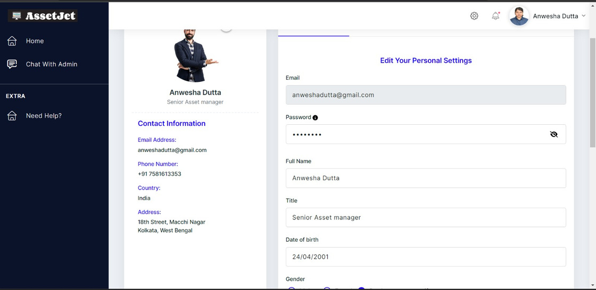
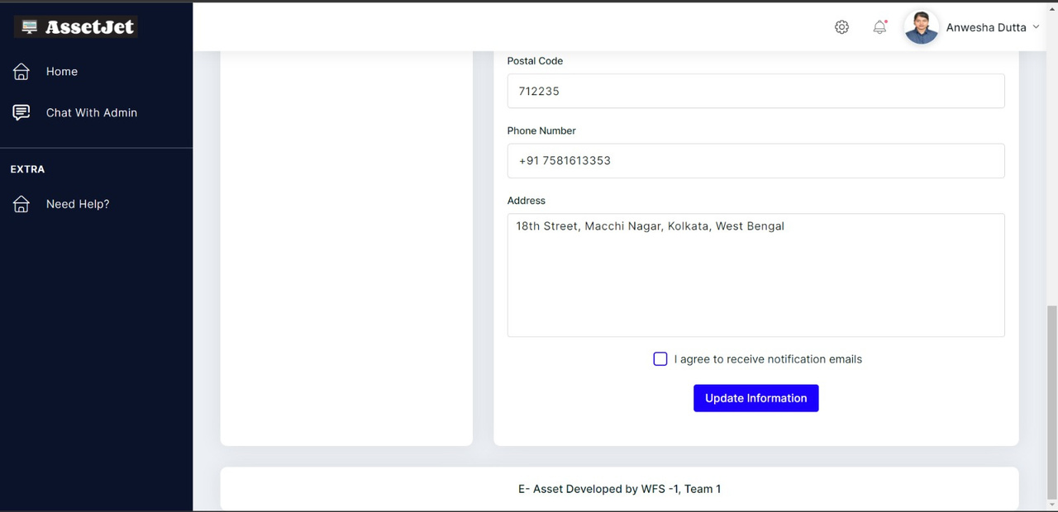
Updating Information Section

Slide 16
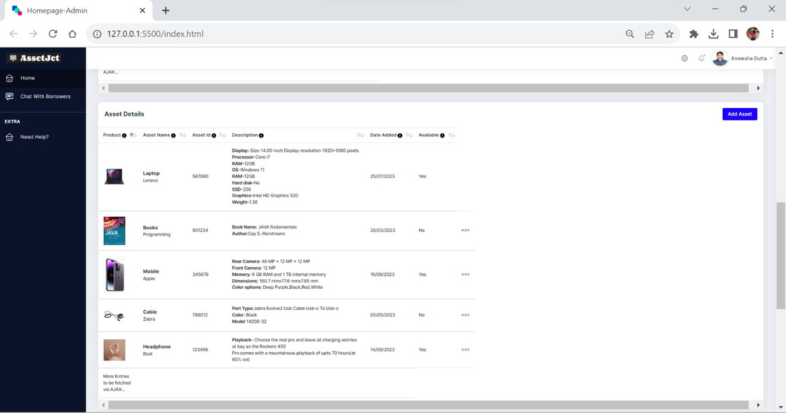
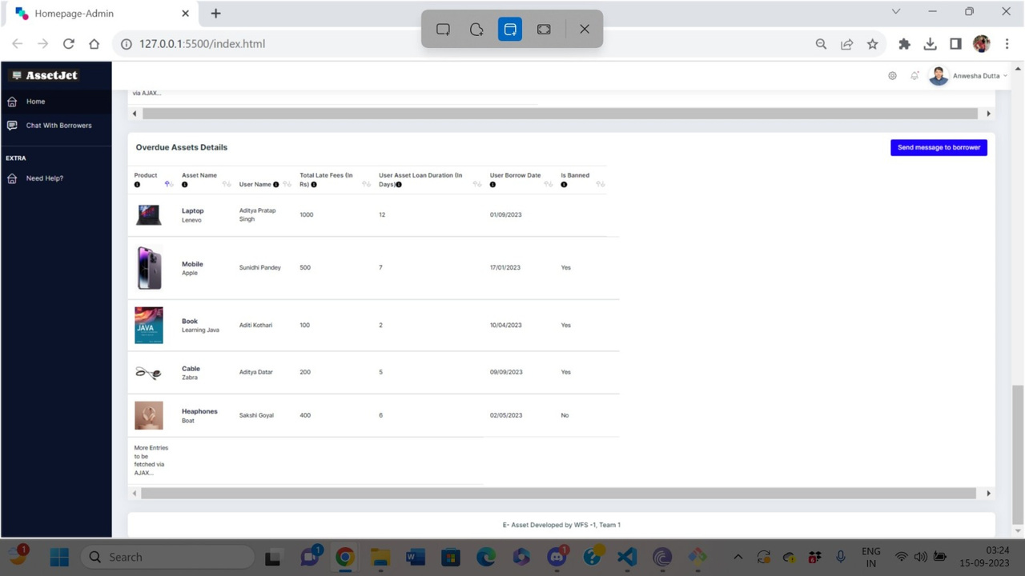

Slide 17
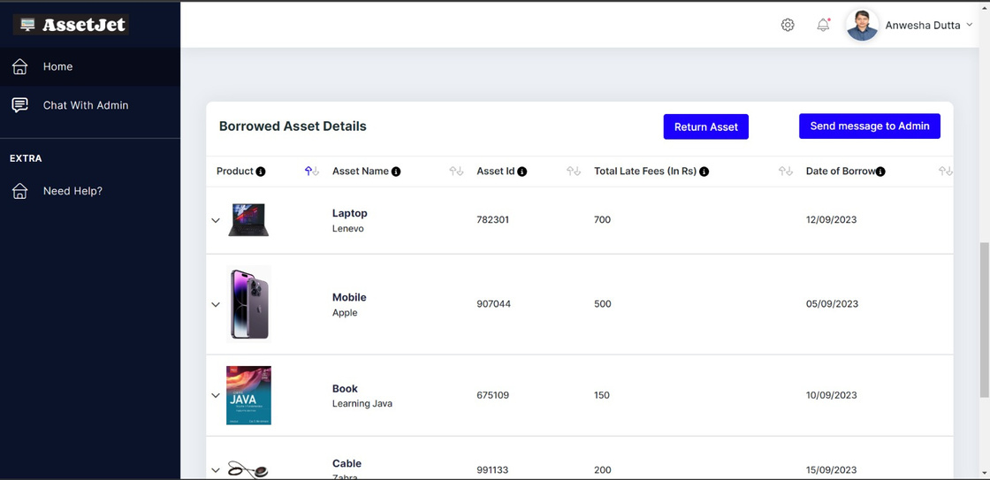
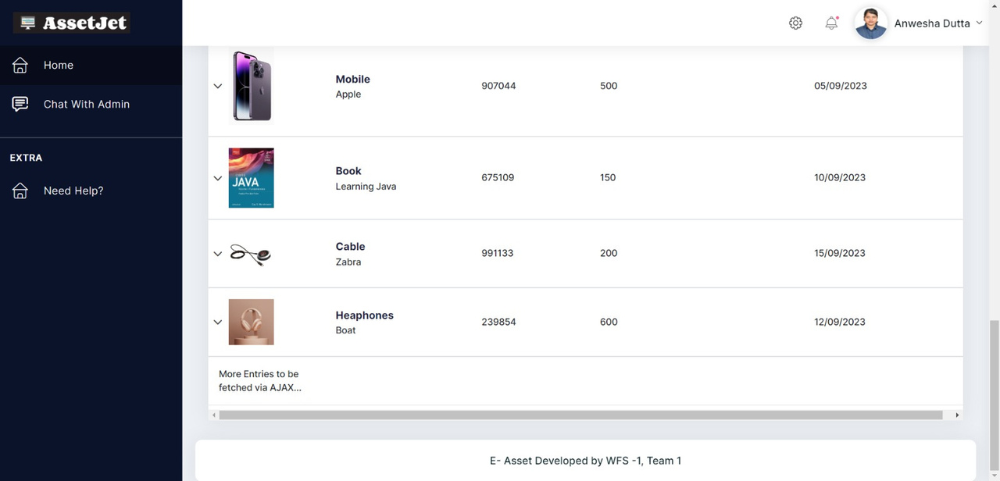

Slide 18
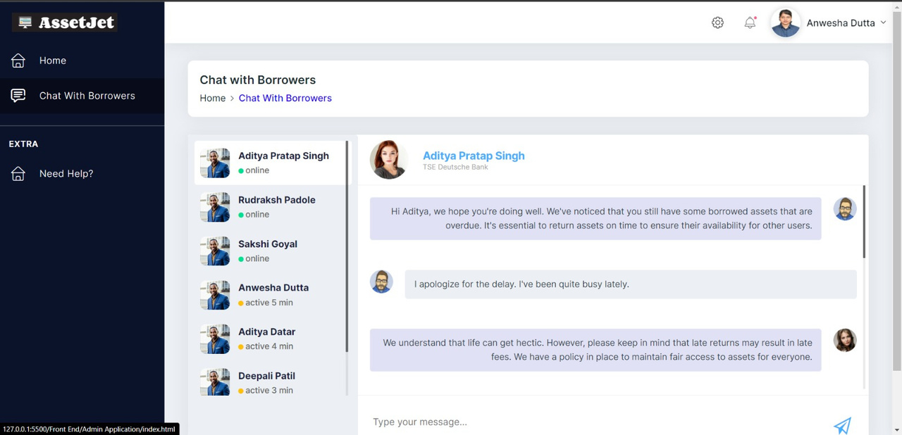
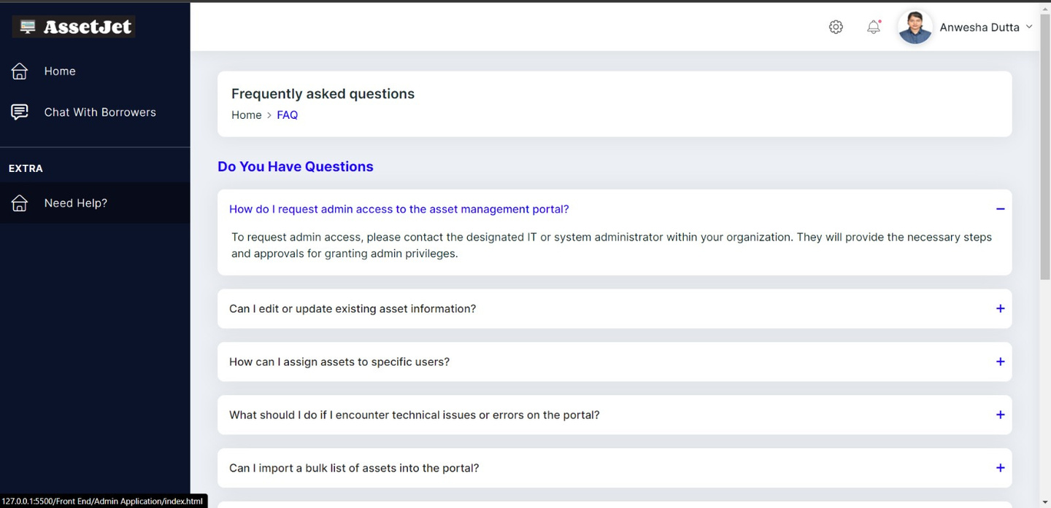
Chat with Borrowers
FAQs

Slide 19
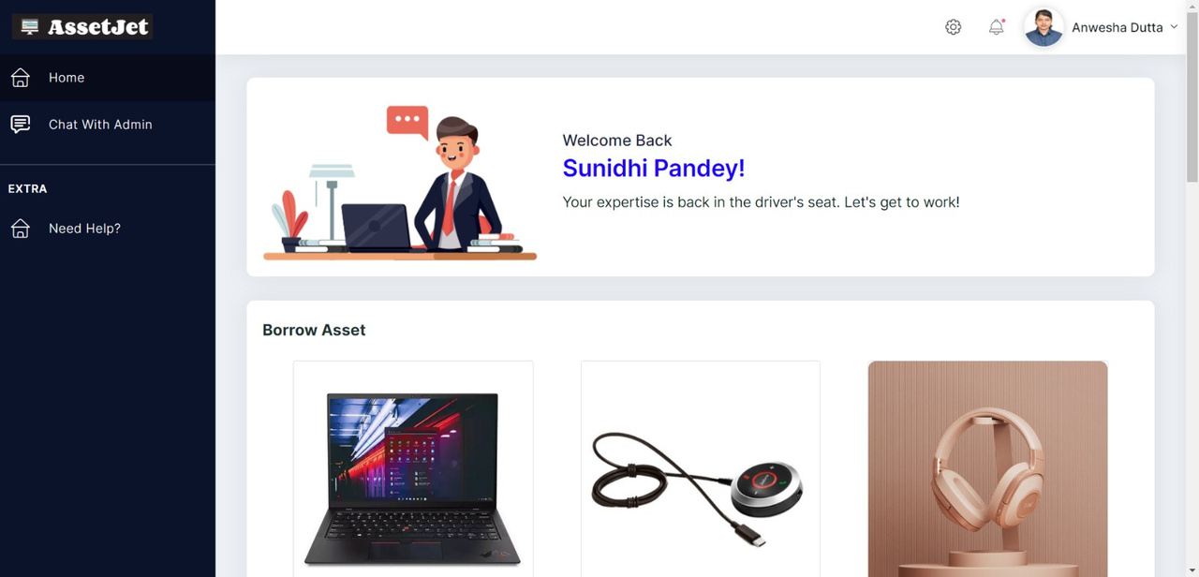
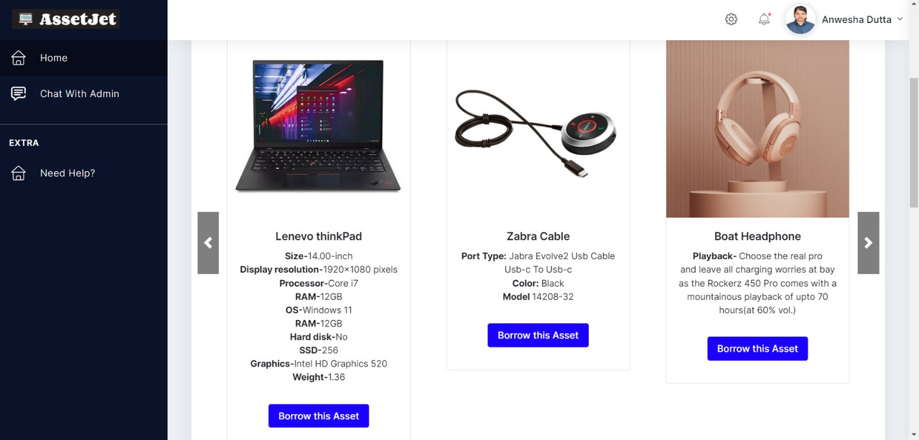
User's Portal

Slide 20
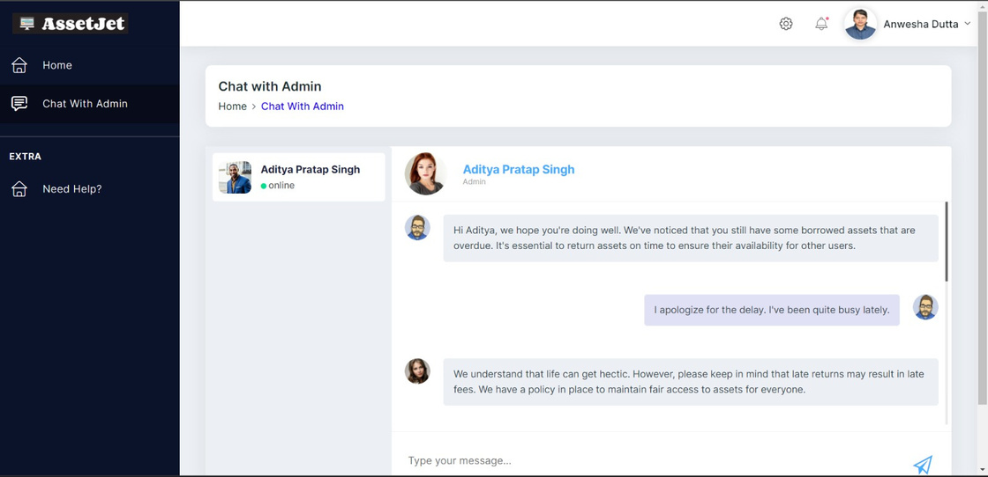
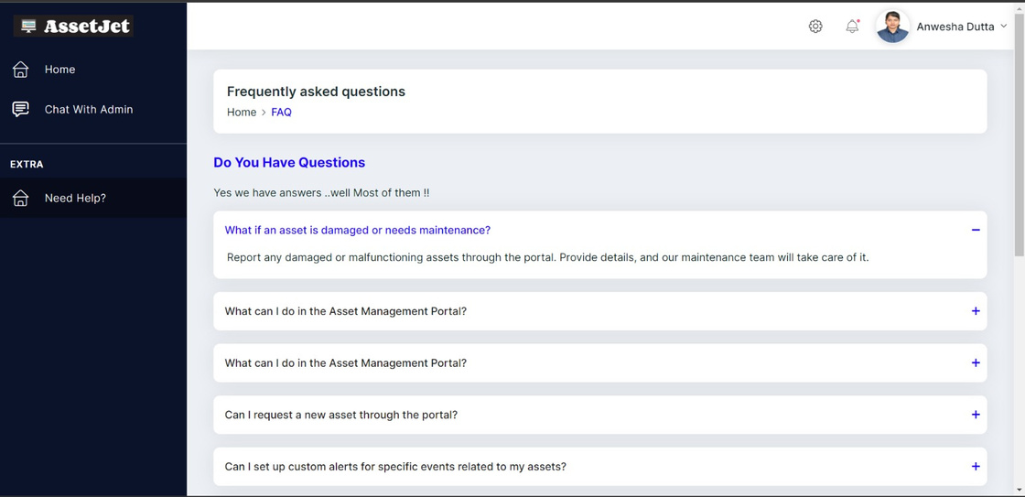
Chat With Admin
FAQs

Slide 21
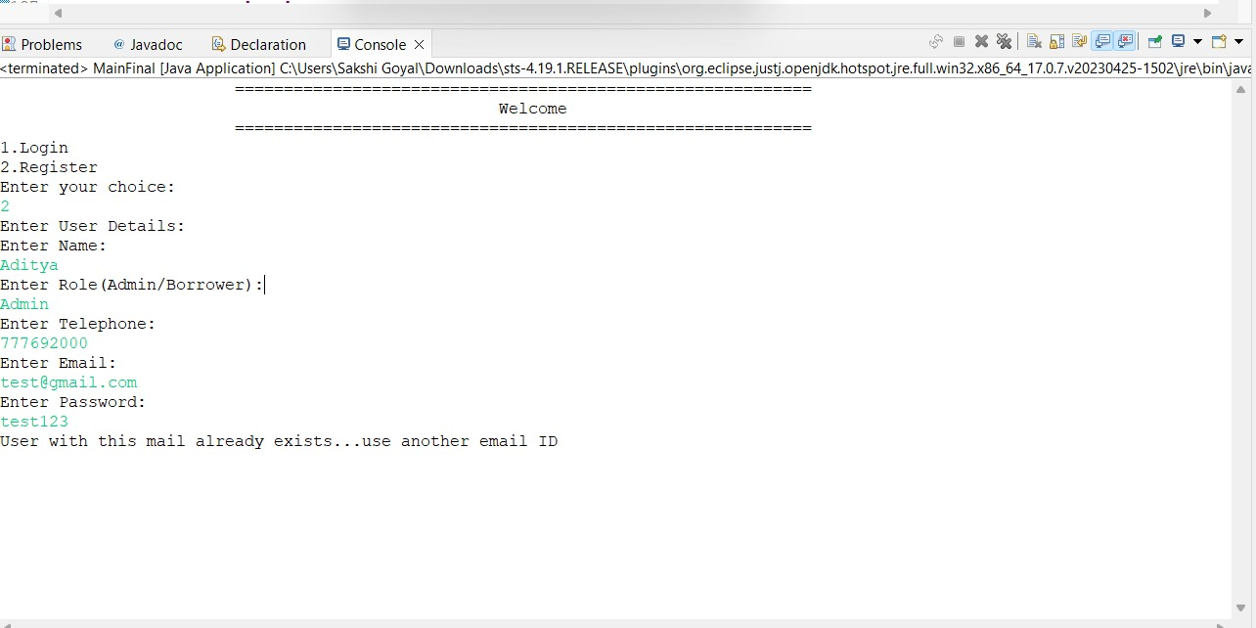
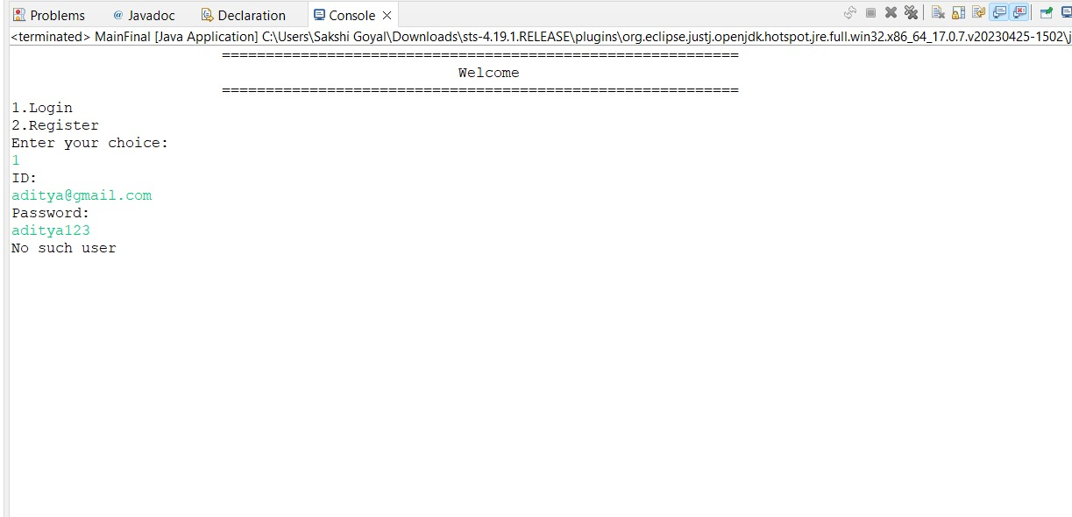
Backend Output

Slide 22
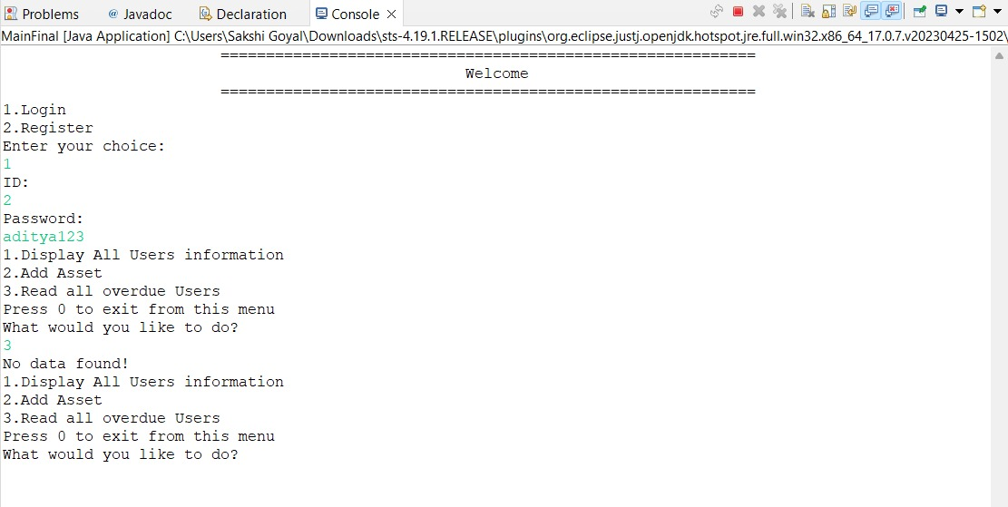
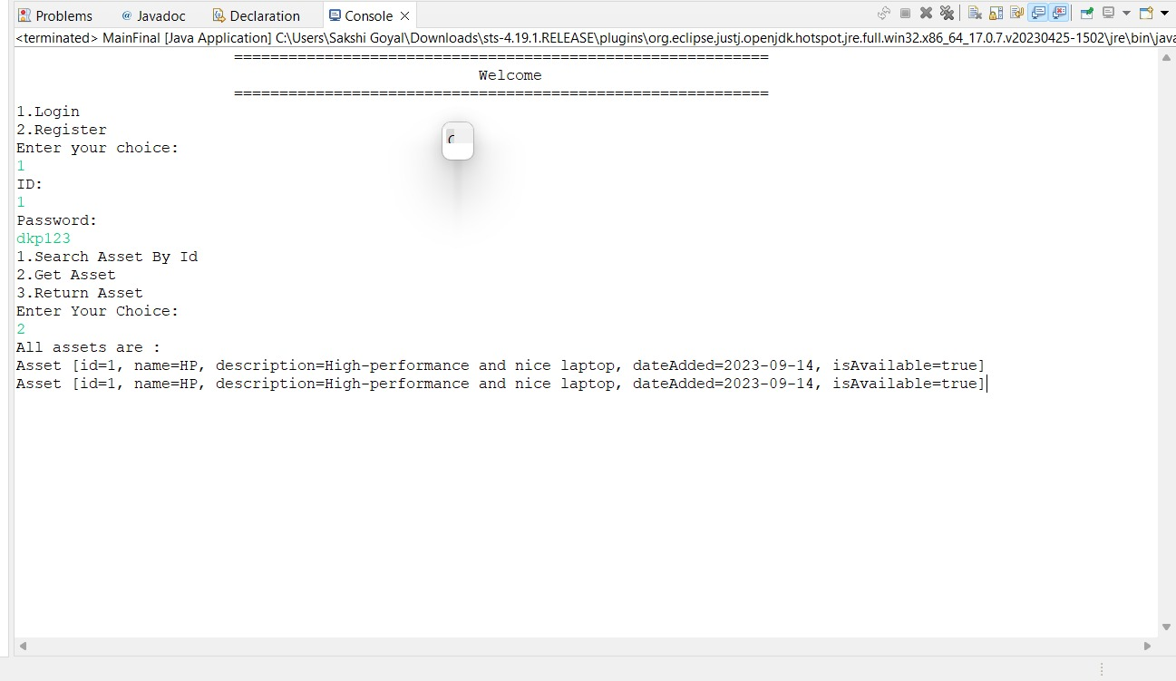
Backend Output

Slide 23
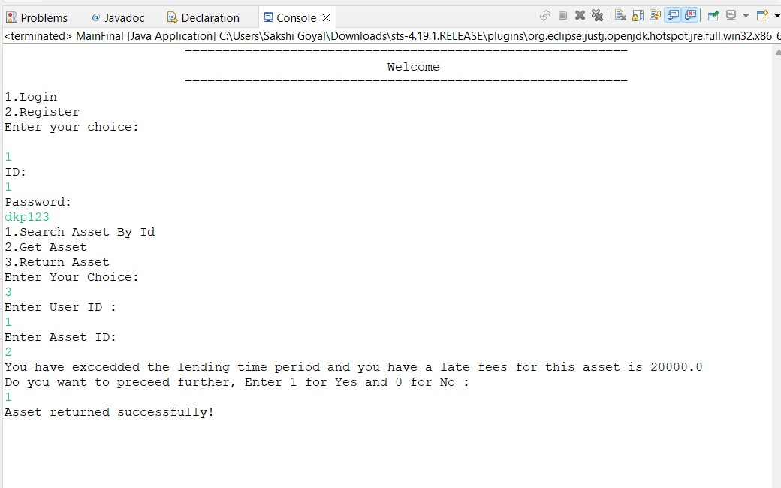
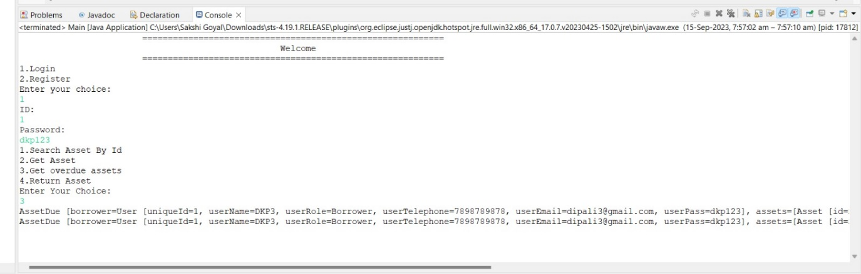
Backend Output

Slide 24


Future Scope
Machine learning can also enhance anomaly detection for security purposes.
Expand Asset Types: Continuously expand the system's capability to accommodate various asset types.
Feedback Mechanism: Create a feedback loop for users to suggest improvements and enhancements, driving continuous development.

Slide 25
Thank you!

